Slide 1
Women in Computing
Done by: Gerda Bortsova

Slide 2
What questions I will try to answer:
Why many people (including me) view a decreased participation of women in computer science (and STEM – Science, Technology, Engineering and Mathematics in general) as problem? Why it could be regarded as a question of ethics, whether to direct efforts to help this problem or not?
Why there are so few women in IT (STEM)?
What could we increase number of women in computer science?

Slide 3
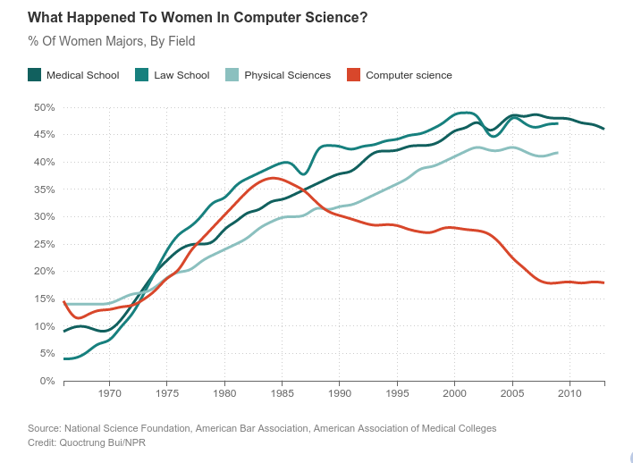
Some figures
Notes:
First of all, I want to give you some figures on proportion of women in computer science. This is historical data.
Decline – maybe because of appearance of personal computer, which was marketed to boys.
In computer science, maybe more than in other fields, prior experience with computing plays important role.

Slide 4
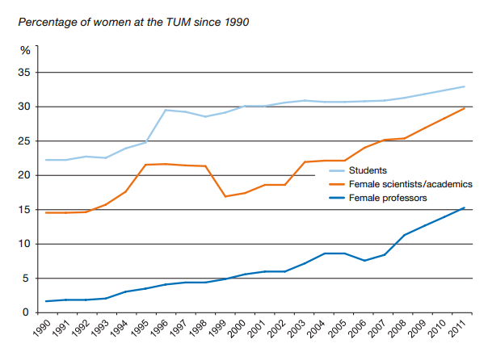
TUM Figures
33% of students,
39% of PhD students,
33% of scientists,
14% of professors are female.
Notes:
The higher you go into hierarchy, the fewer women you’ll find.

Slide 5
TUM Figures: by major overall
Students by Department | % of females | Students by Department | % of females
Architecture | 56% | Munich School of Engineering (MSE) | 31%
Chemistry | 41% | Physics | 18%
Civil, Geo and Environmental Engineering | 34% | Sport and Health Sciences | 53%
Electrical, Electronic and Computer Engineering | 14% | TUM School of Education | 63%
Informatics | 16% | TUM School of Life Sciences Weihenstephan | 53%
Mathematics | 30% | TUM School of Management | 33%
Mechanical Engineering | 14% | TUM School of Medicine | 62%

Slide 6
TUM Figures: PhD by major
Department | % of female | Department | % of female
Architecture | 50%
Chemistry | 39% | Physics | 18%
Civil, Geo and Environmental Engineering | 22% | Sport and Health Sciences | 54%
Electrical, Electronic and Computer Engineering | 9% | TUM School of Education | 92%
Informatics | 8% | TUM School of Life Sciences Weihenstephan | 55%
Mathematics | 29% | TUM School of Management | 42%
Mechanical Engineering | 15% | TUM School of Medicine | 61%

Slide 7
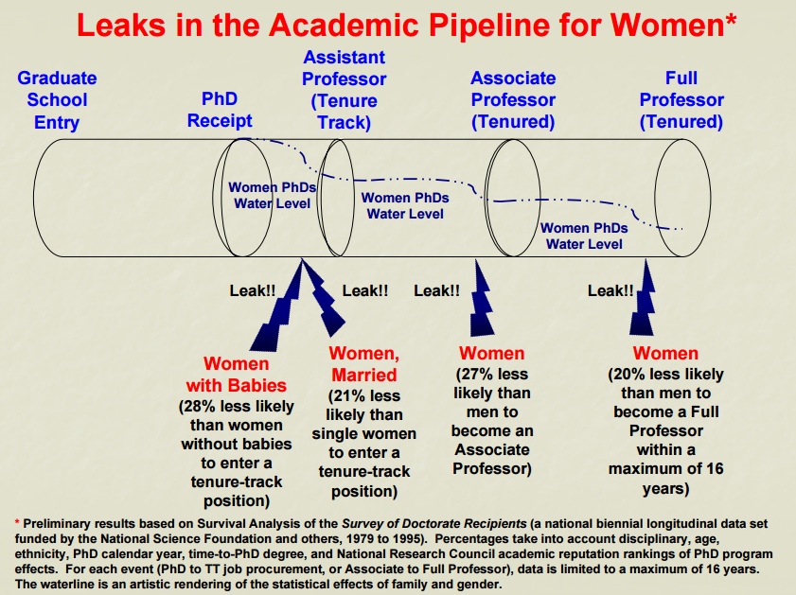
Notes:
Question of underrepresentation of women is not only about that women don’t pursue IT careers, but also about that they are leaving the field. Referred to as leaky pipeline.
Of course, it varies by country, but almost every where women are significantly underrepresented in IT.
Difficult to find statistics about Europe.

Slide 8
Why is this a problem?
According to prediction, in USA by 2018 there will be 1.4 million open technology jobs in the United States and, at the current rate of students graduating with degrees in computer science, only 61% of those openings will be filled—and just 29% of applicants will be women.
In Scotland, a large number of females graduate in STEM subjects but fail to move onto a STEM career compared to that of men. According to The Royal Society of Edinburgh, this represents a £170 million per annum loss to Scotland's national income.
A supply of IT professionals doesn’t meet a growing demand.
Notes:
I’ll first examine the most “pragmatic” reasons.
What people frequently provide as a reason:
If to think of a problem from point of view of a single country, to withstand the competition with other countries, add people from minorities.
With increasing number of women in IT, you can help economics.
The U.S. Department of Labor Statistics predicts that by 2018 there will be 1.4 million open technology jobs in the United States and, at the current rate of students graduating with degrees in computer science, only 61% of those openings will be filled—and just 29% of applicants will be women.
In Scotland, a large number of females graduate in STEM subjects but fail to move onto a STEM career compared to that of men. This is a huge loss to the economy and society. According to The Royal Society of Edinburgh[10], this represents a £170 million per annum loss to Scotland's national income.

Slide 9

Why is this a problem? II
A number of studies show, that diverse teams perform better
Diversity could be seen as antidote to so-called groupthink
Women can actually make computer science better!
Notes:
Groupthink is a psychological phenomenon that occurs within a group of people, in which the desire for harmony or conformity in the group results in an irrational or dysfunctional decision-making outcome.
We can make computer science better.

Slide 10
Why is this a problem? III
34% higher return investment when women are in leadership positions
40% higher citation for patents with women co-inventors vs. those with men only inventors

Slide 11
What are the ethical implications? I
Social inequality
STEM fields provide a great number of good jobs, including highly prestigious and well-paid
In the future, a huge shortage is predicted:
E.g., a 2012 report from the President’s Council of Advisors on Science and Technology indicates that training scientists and engineers at current rates will result in a deficit of 1,000,000 workers to meet United States workforce demands over the next decade.
Notes:
I’ll move on now what is actually WRONG (wrong from ethical point of view) with having women underrepresented in STEM and computer science in particular.
The disparity of men and women in these fields contributes to social inequality.
Unfortunately, many women loose these opportunities.

Slide 12
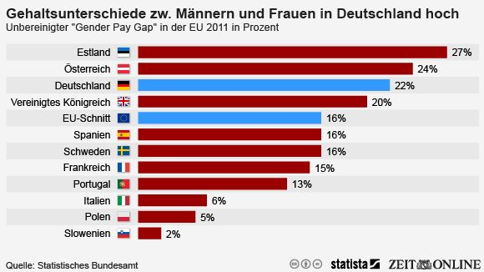
The pay gap
Germany: > 3,000 euro gap in annual salary in IT field
Notes:
Speaking about well paid jobs, the pay gap still persists. Partially it’s coming from horizontal segregation in labor market bw men and women. That is male-dominated professions tend to be better paid.

Slide 13
Discrimination
Prevents women to obtain higher positions and earn more money

Slide 14
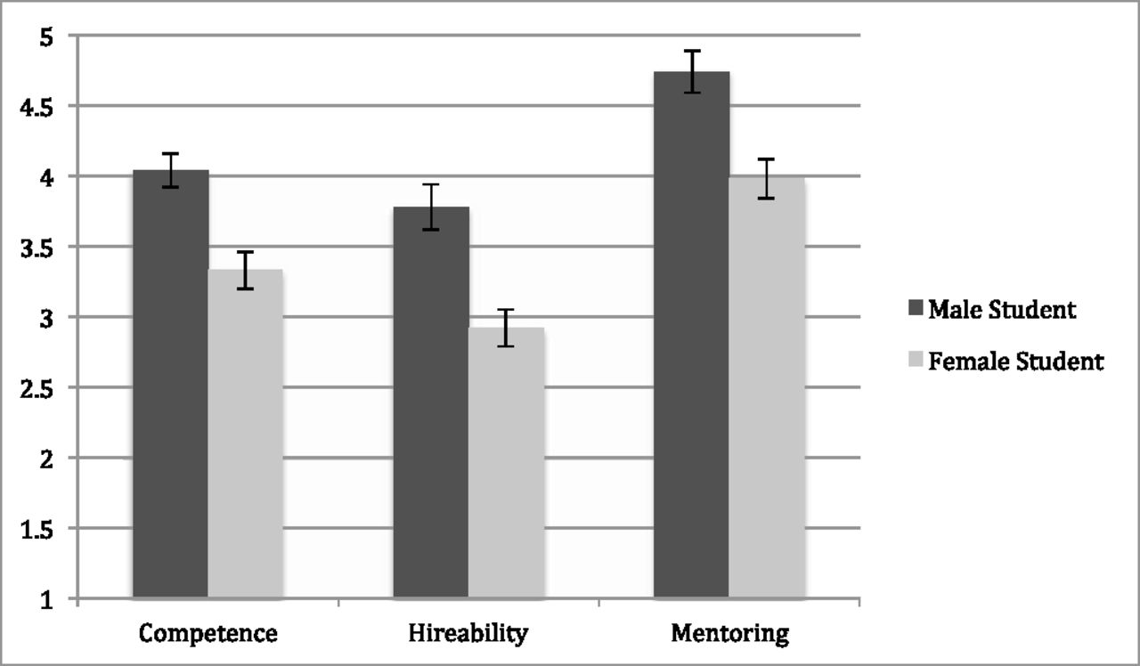
Competence, hireability, and mentoring by student gender condition

Slide 15
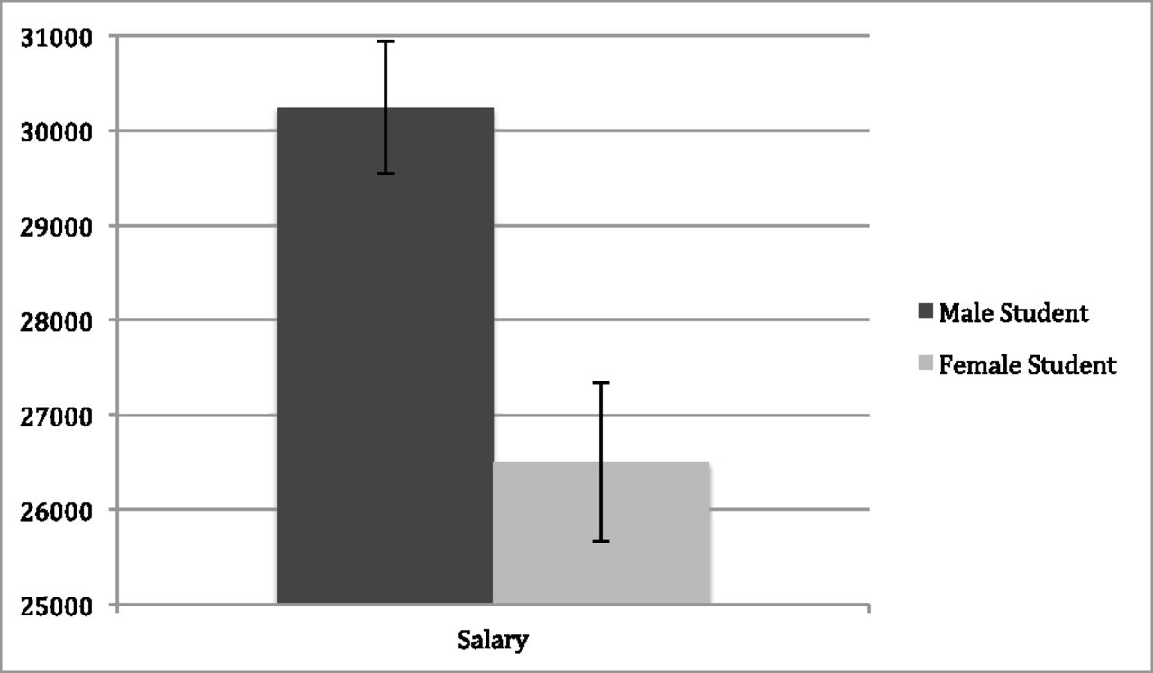
Salary conferral by student gender condition

Slide 16
Explanations of low number of women in IT
Stereotypes
People tend to conform with the expectations placed on them by society
Works through e.g. stereotype threat, self-fulfilling prophecy

Slide 17
Self-fulfilling prophecy
Expectancies people have towards others may lead to a behavior confirming these expectancies.
Classical experiment of Rosenthal & Jacobson (1968):
The researchers gave an IQ test to elementary school children
They gave to the teachers of the school a list of “high-scorers”, which were, however, chosen randomly, rather than on the basis of test results
Year after these children really showed significantly better improvement in comparison with “average” children

Slide 18
How these expectancies are transmitted?
People can subconsciously behave in a way to trigger the behavior they expect from the other person.
If you think I’m talkative, you may behave in a way that encourages me to speak more.
If students think their teacher is mean, they may act in a way to cause him/her to be mean.
If parents of a girl think she is reluctant to use computer, they may act in a way to cause her feeling reluctance when facing computer.
Notes:
You may wonder, how these expectancies can be really transmitted from a teacher to student, if they are unspoken? People cannot read each other minds.
The probable answer is that people can subconsciously behave in a way to trigger the behavior they expect from the other person.

Slide 19
Stereotype threat

Slide 20
Self-fulfilling prophecy

Slide 21
Biological differences
The most popular explanation for decreased participation of women in science, medicine, etc. – not sufficient brain capacity [link]
What scientists can do?
They can measure the amount of grey matter in the brain: there are differences, but it’s hard to interpret them
Some claim hormones make difference
They can experiment with newborns: no difference [link]

